Slide 1
Health & Wellness:
Personal Health
Jenn Hu, Angel Pan, AJ Rossman, Emily Yang

Slide 2
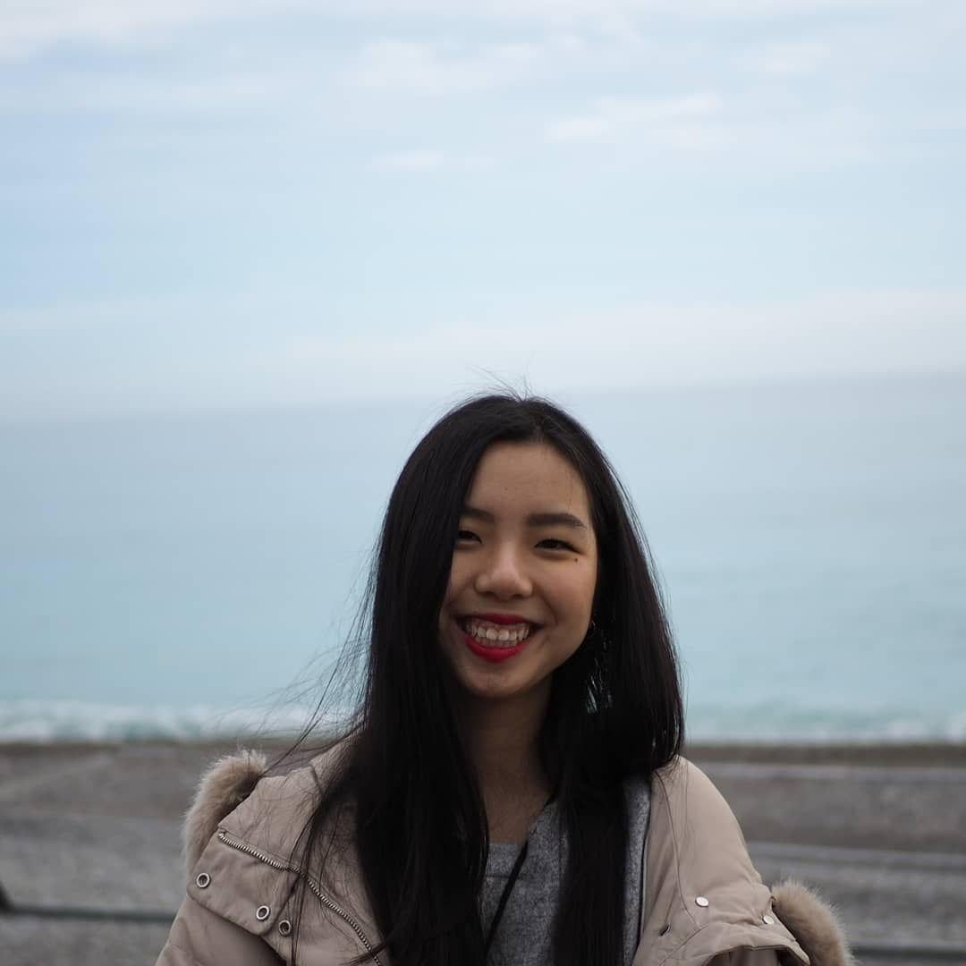
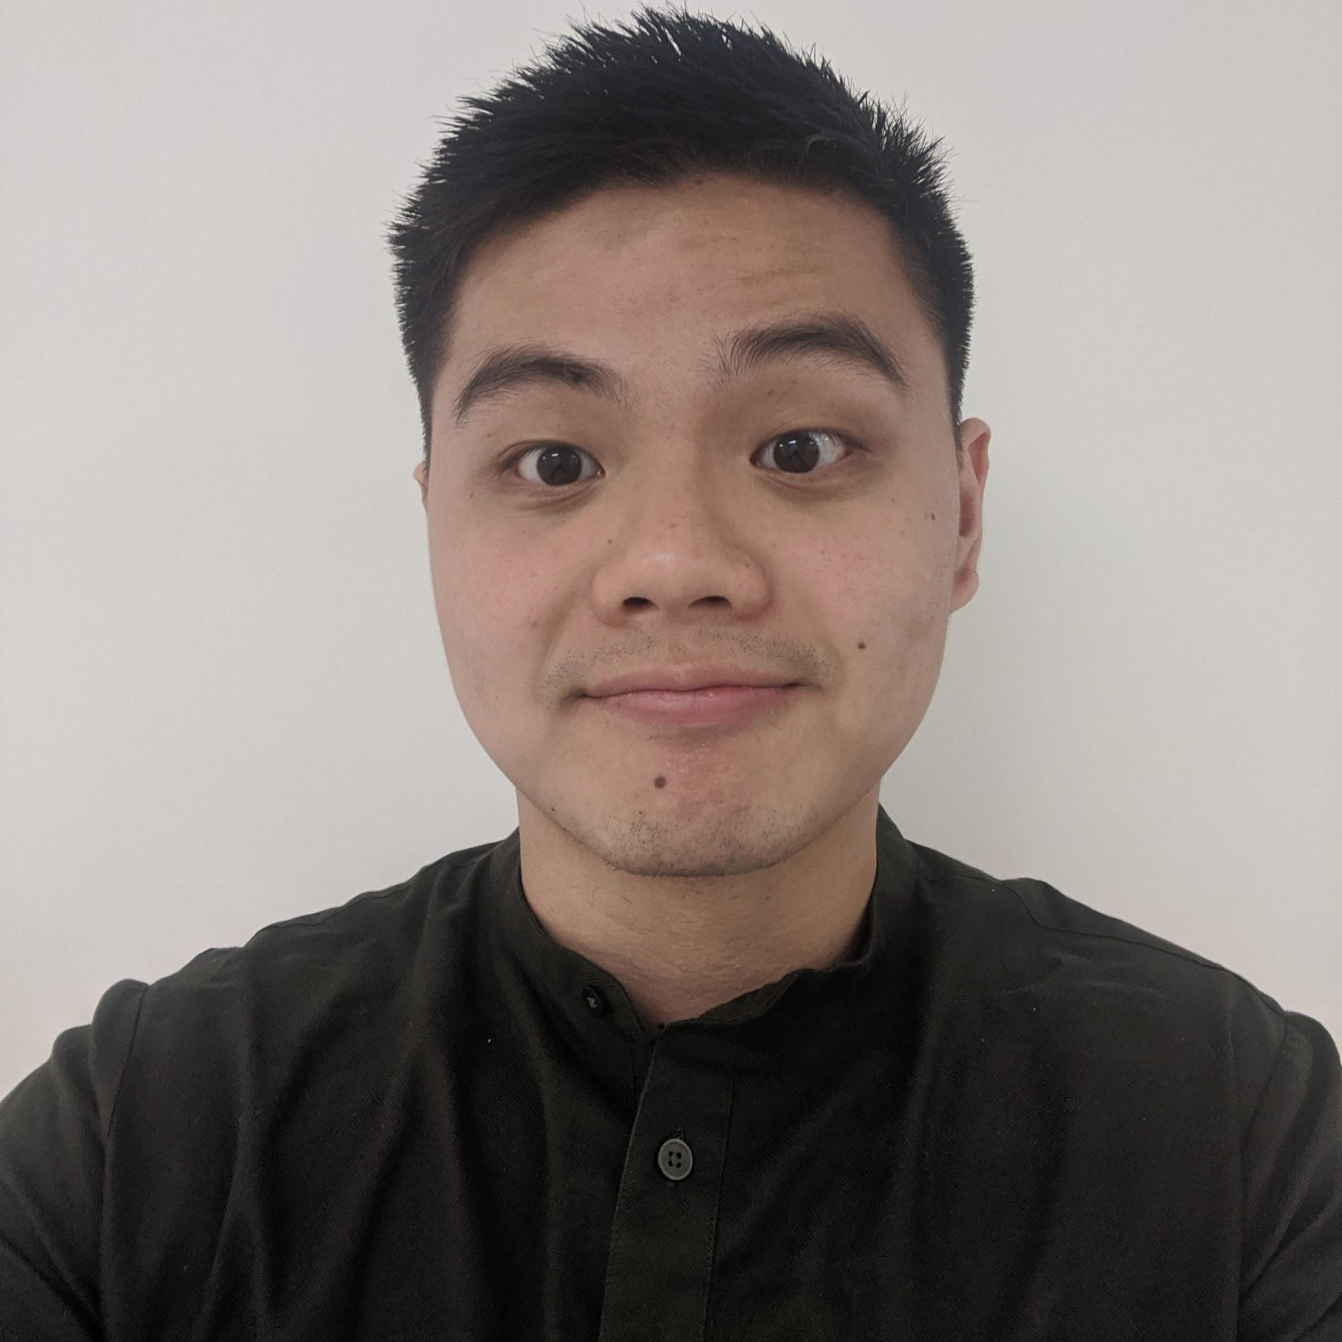
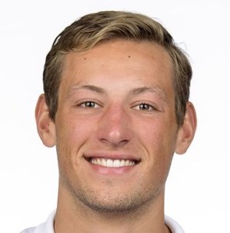
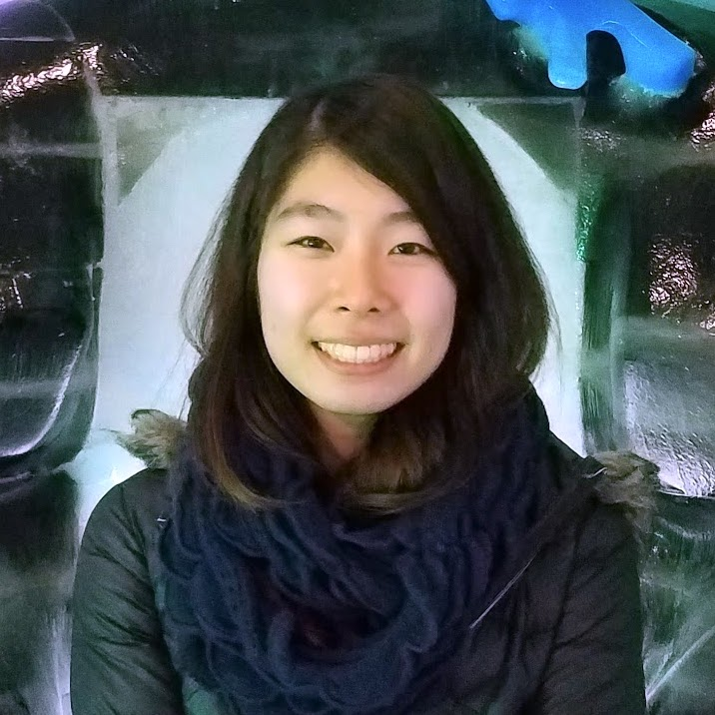
Meet the Team
Jenn Hu
Senior
IR Undergrad
Angel Pan
Senior
CS Undergrad
AJ Rossman
Junior
CS Undergrad
Emily Yang
First-year
MSCS

Slide 3
Needfinding Methodology

Slide 4

Outreach
Active:
Physical & Mental
Active: Physical
Not Active: Mental
Not Active: Physical
Active: Mental
Not Active: Physical & Mental
21+ years
Notes:
Make sure to say:
who your participants were
why chosen
how they were recruited/compensated
where they were interviewed

Slide 5
Questions
What does personal wellness mean to you?
?
What are some struggles you encountered?
Tell me
what your
ideal wellbeing is like?
How do you currently engage with physical/mental wellness?
How does personal wellness have an effect on your life?
How has
your idea of personal wellness changed over
the years?
Tell me something about wellness you wish you knew about earlier?

Slide 6
Interview Results

Slide 7
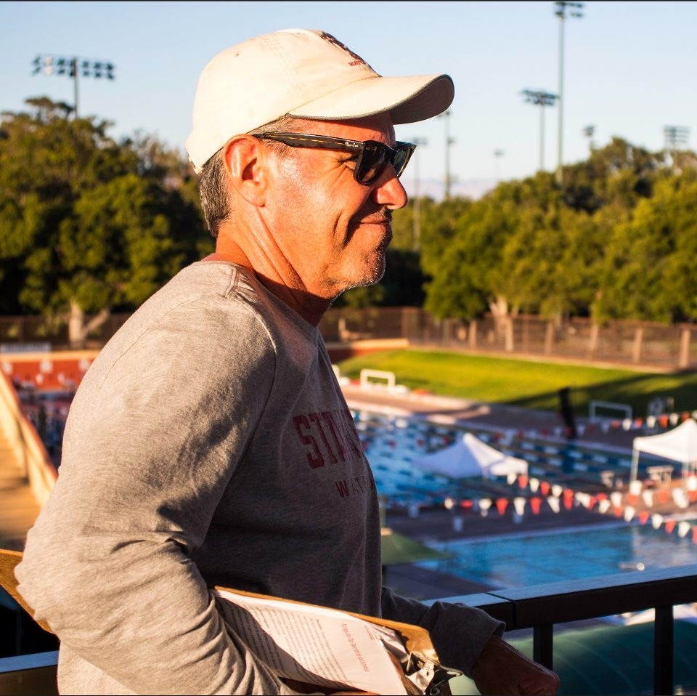
Interviewee 1
“I had been training for 6, 7 hours a day for years. After the Olympics, I felt like I couldn’t have a good workout if it wasn’t for 3 hours.”
John Stanford Men’s Water Polo coach

Slide 8
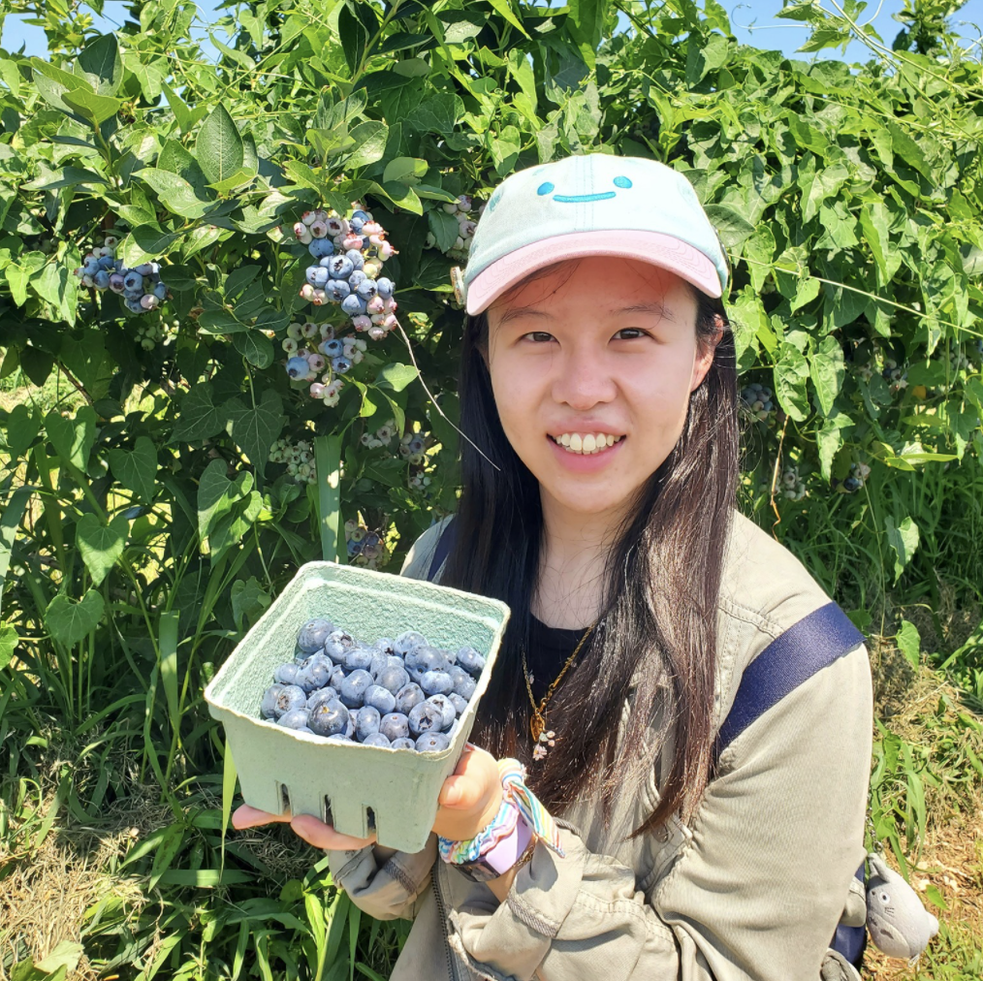
Interviewee 2
“Starting was always the hardest, but once I got past the mental block and got the habit going and committing to it, it got easier and I gained confidence.”
Sherry
Law Firm Finance Analyst
Notes:
Extremely active physically and mentally
Physically:
Exercises every day
Tries to go outside every day
Feels motivated and enjoys moving and feeling like a functional human being
Enjoys sports because of the social aspect and makes it easier to get into
Has a daily routine for exercising
Mentally:
Does introspection on a daily basis, assesses how she feels and her emotions often
Does not do journaling or record things down
Copes with feelings by distracting herself with hobbies (art, baking)
Enjoys going on IG to look at motivational posts & quotes, cute comics
Believes if you’re mentally healthy, can go into any type of relationship with a good mindset

Slide 9
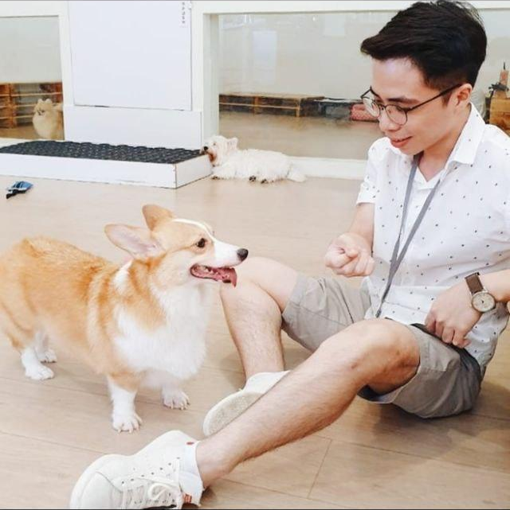
Interviewee 3
“In my pursuit of wellness, my community has been integral in keeping me accountable and reminding me that I am not on this journey alone.”
Michael Second-year university student in Singapore
Notes:
Get insights from an international perspective -- such that we can understand universal struggles and needs in the wellness space that exist regardless of history and culture.
Extremely active mentally, less active physically
Mentally:
Silent time is important; 45 minutes in silence to reflect and be present
Goes on walks
Avoids electronic devices during these times because it steals attention from present
Listens to music: classical music
Seeks the listening ear of friends to keep oneself accountable
Physical:
Exercises three times a week
Tools wise, uses tabata timers, running trackers, music apps
Exercise is a way of developing discipline, subjects the body to the mind
Struggles:
Laziness
Lack of motivation which stems from distractions and discouragement
How they overcame struggles:
Don’t do it alone - community is super important in keeping oneself accountable
Community reminds you that you are not going at it alone
Believes that:
Setting intentions is important in reaching your wellness goals
Physical wellness goes beyond looking good and even feeling good; it is about building discipline and connecting the mind with the body
Mental wellness is the ability to know what is good and pursue the good (instead of being hindered by fear or anxiety or other inhibitions)

Slide 10
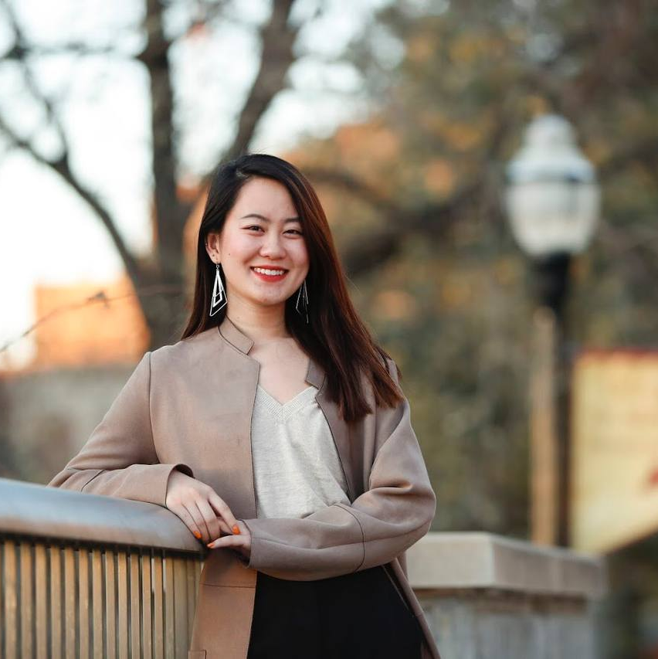
Interviewee 4
“A really big issue for me in general is consistency, [but] what I have noticed is that I have the most motivation when physical wellness is coupled with social aspects.”
Jenny Fourth-year university student in Minnesota
Notes:
Extremely active mentally, not active physically
Mentally:
Speaks with virtual therapist every 3-4 months
Therapist helps nudge her in the right direction if notices something is awry
Journals as a way to release negative emotions
Word vomit on notes app on phone to release but also to look back on later as a reminder of progress
Does whatever her body needs her to do at the moment (sleep, cry, eat, etc.)
Talks to people she can trust to help her work through her feelings
Physical:
Does not do anything day to day; trying to develop a new routine of stretching daily
Used to walk around campus pre-covid
Used to be on the tennis team in high school (peak physical wellness)
Pockets of physical wellbeing, one week here and there of steady routine before it breaks
Struggles:
Went through several mental lows in college before she was mentally active
Hard to maintain a habit or stick to a routine; difficult to push through feeling of not wanting to do something
How they overcame struggles:
Overcame mental lows through trial and error of different things until found something that works for her
Has managed to maintain habits in the past when motivated by social aspects as well
Believes that:
Personal wellness includes: Physical, emotional, mental, social, and financial wellbeing
Mental wellness does not mean always being happy but being able to understand your feelings and knowing how to deal with feelings in a healthy way
When physical wellbeing is not in balance, she feels bad or may do things she does not want to.
Physical wellness is not as urgent for her right now because she is decently healthy nutritionally even if she is not physically active
Because it is not as urgent, when she is busy it is easily ignored
She is most motivated when there are social pressures to keep her accountable and help her push through

Slide 11
Analysis

Slide 12
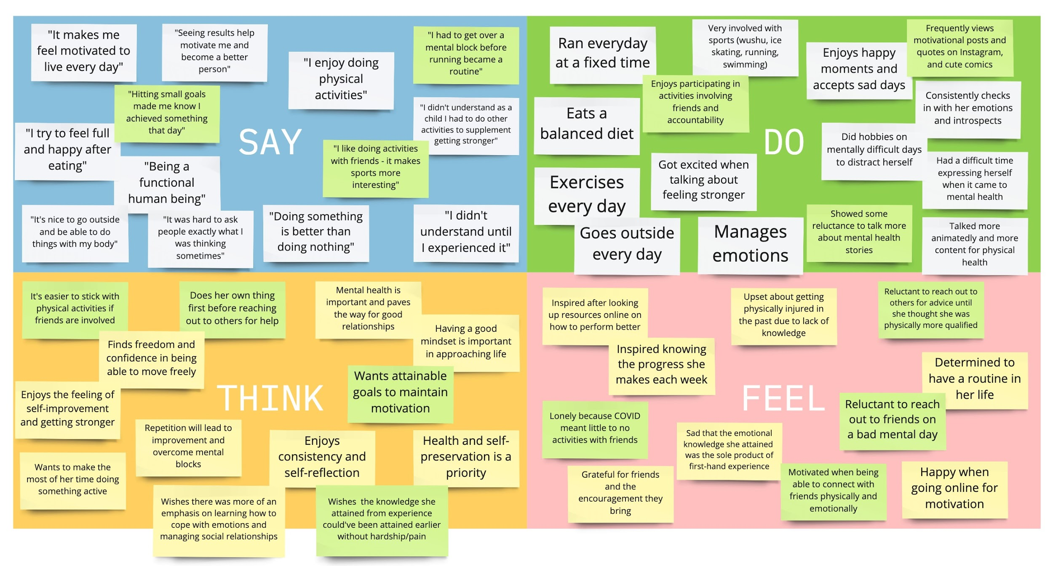
Empathy Map
Notes:
Don’t need to go super in depth with this slide - just to visually show how our empathy graph ended up

Slide 13
SAY
"It makes me feel motivated to live every day"
"Seeing results help motivate me and become a better person"
"I enjoy doing physical activities”
"I had to get over a mental block before running became a routine"
“I try to feel full and happy after eating”
“Hitting small goals made me know I achieved something that day”
"I like doing activities with friends - it makes sports more interesting”
“I didn’t understand as a child I had to do other activities to supplement getting stronger”
"It’s nice to go outside and be able to do things with my body”
“Being a functional human being”
“It was hard to ask people exactly what I was thinking sometimes”
“Doing something is better than doing nothing”

Slide 14
DO
Exercises every day (i.e. running)
Very involved with sports (wushu, ice skating, running, swimming)
Enjoys happy moments and accepts sad days
Eats a balanced diet
Frequently views motivational posts and quotes on IG, and cute comics
Enjoys participating in activities involving friends
and accountability
Did hobbies on mentally difficult days to distract herself
Consistently checks in with her emotions and introspects
Had a difficult time expressing herself when it came to mental health
Got excited when talking about feeling stronger
Showed some reluctance to talk more about mental health stories
Talked more animatedly and more content for physical health

Slide 15
THINK
It’s easier to stick with physical activities if friends are involved
Finds freedom and confidence in being able to move freely
Does her own thing first before reaching out to others for help
Mental health is important and paves the way for good relationships
Enjoys the feeling of self-improvement and getting stronger
Wants to make the most of her time doing something active
Repetition will lead to improvement and overcome mental blocks
Enjoys consistency and self-reflection
Health and self-preservation is a priority
Wishes knowledge she obtained from experience could've been done without hardship/pain
Wishes there was more emphasis on learning how to cope with emotions & managing social relationships
Wants attainable goals to maintain motivation

Slide 16
FEEL
Inspired after looking up resources online on how to perform better
Inspired knowing the progress she makes each week
Upset about getting physically injured in the past due to lack of knowledge
Reluctant to reach out to others for advice until she thought she was physically more qualified
Lonely because COVID meant little to no activities with friends
Grateful for friends and the encouragement they bring
Sad that the emotional knowledge she obtained was primarily from first-hand experience
Determined to have a routine in her life
Reluctant to reach out to friends on a bad mental day
Motivated when being able to connect with friends physically and emotionally
Happy when going online for motivation

Slide 17
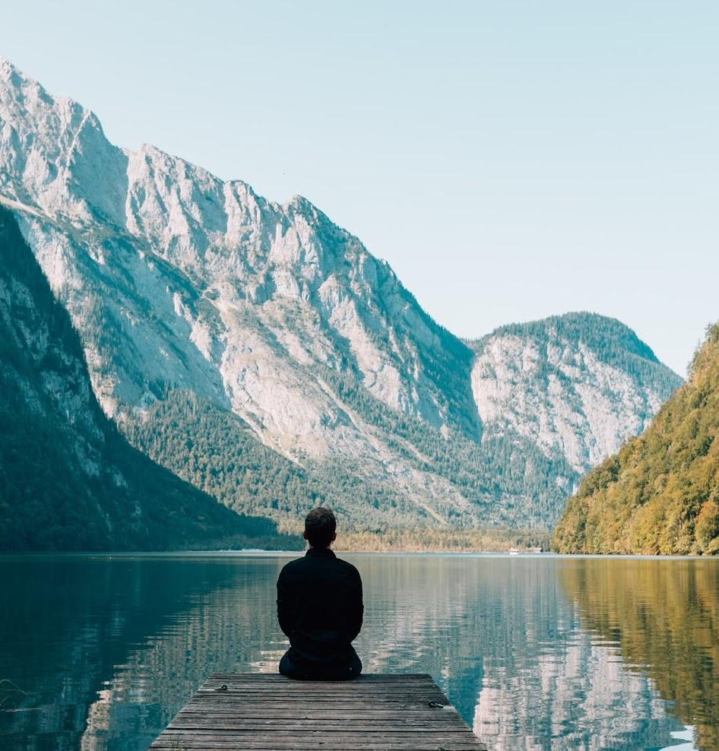
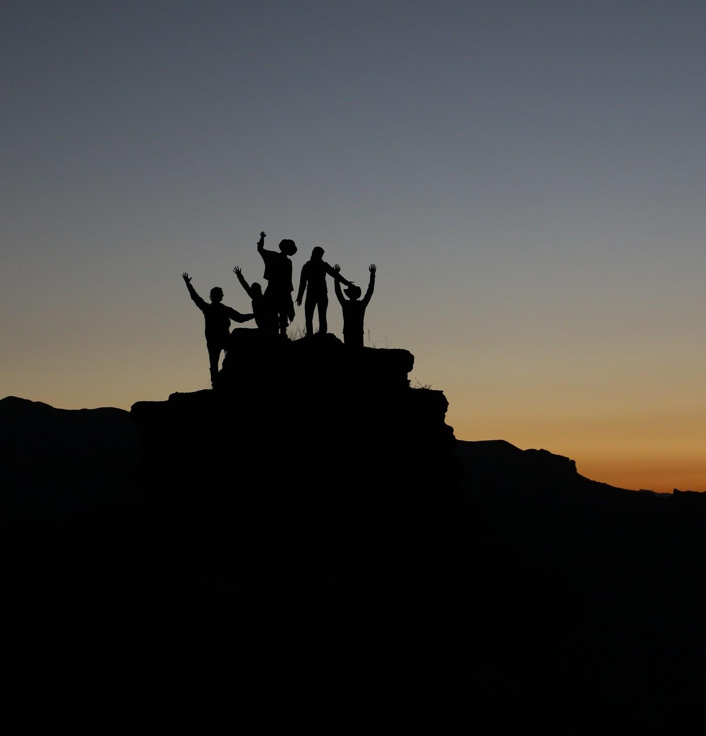
Contradictions & Surprises
Needs alone time….
BUT also needs community for support!
Notes:
Perhaps can link this later to knowing WHEN to ask for help - so you can achieve a balance of both quiet/alone time and having the support system you need.

Slide 18
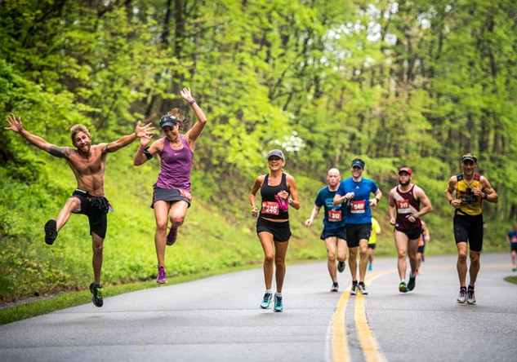
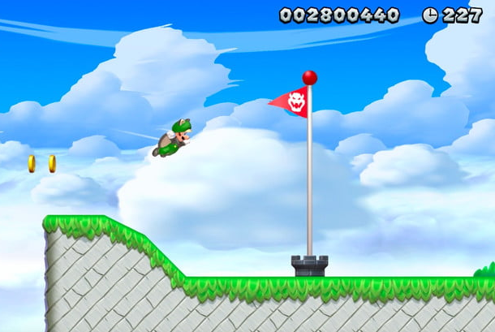
Contradictions & Surprises
Reluctant to reach out to others for advice until they were at a certain physical prowess...
BUT enjoys doing activities if it involves interacting with friends

Slide 19

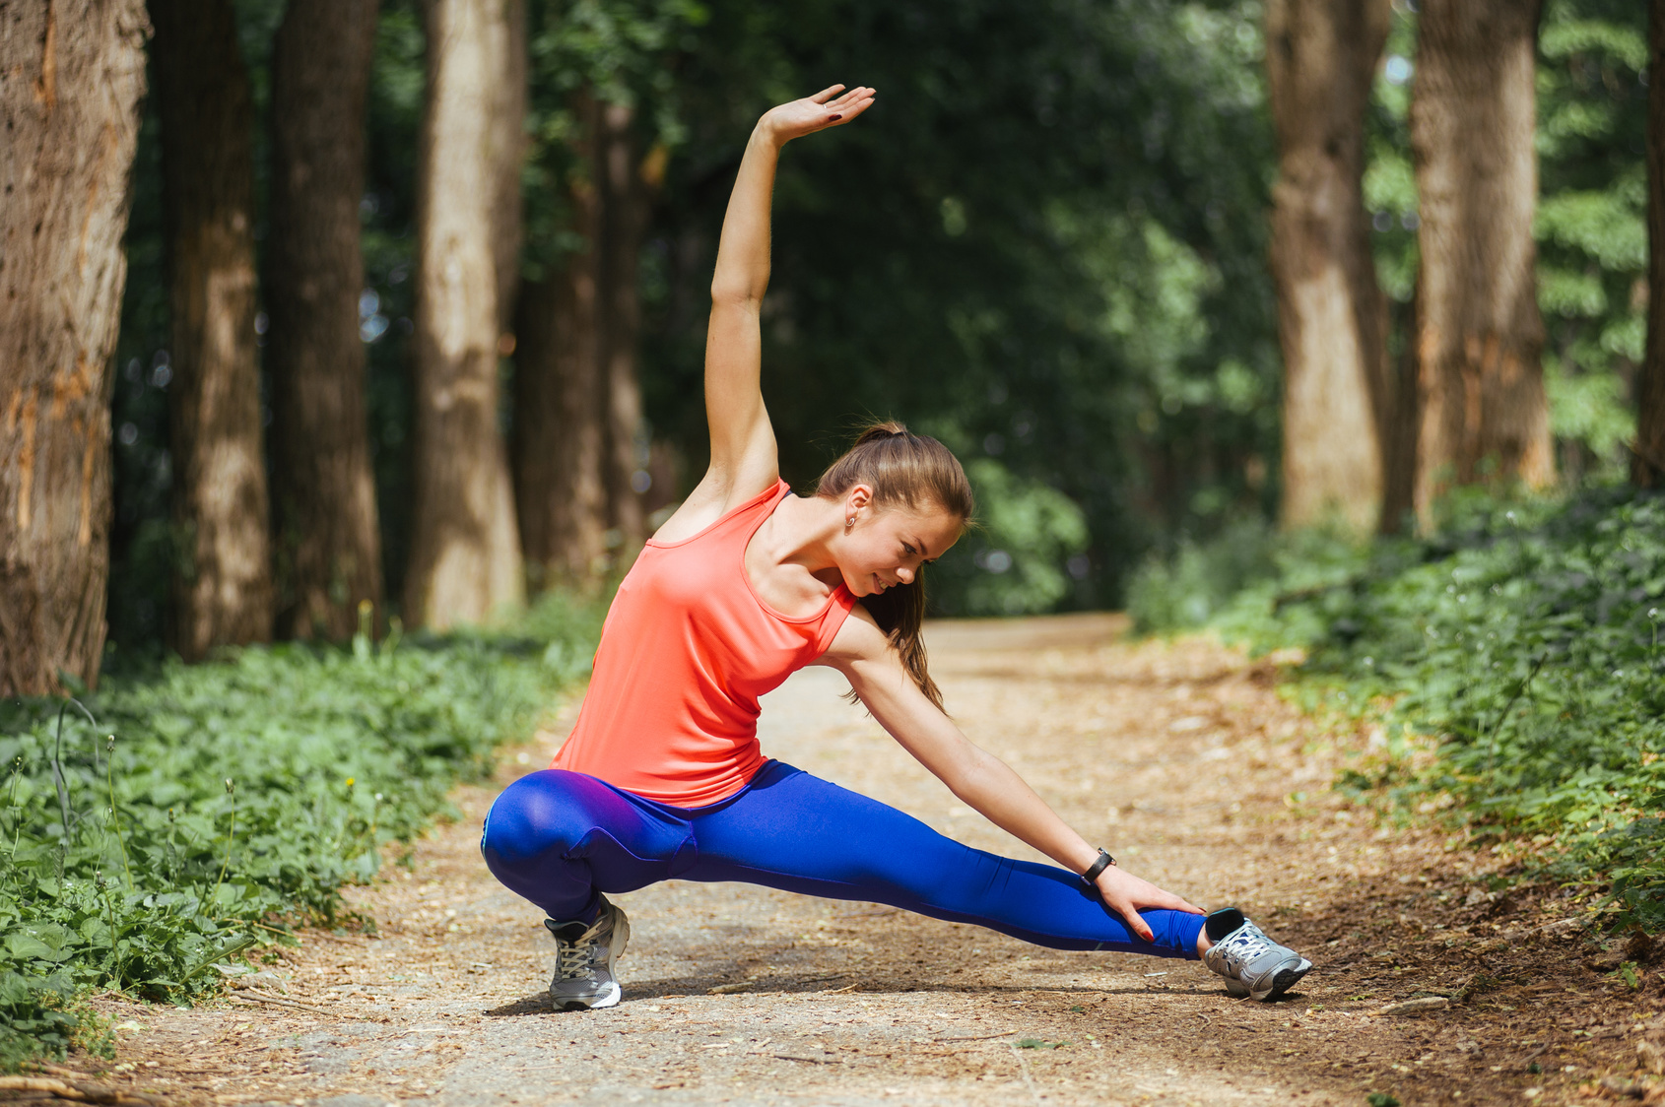
Contradictions & Surprises
Claims that physical wellness is really important...
BUT it is one of the first things to be dropped when things gets busy
Notes:
Perhaps can link this to the difficulty with sticking to a routine and how social pressures can help aid this - it is something important but not urgent (still functional)

Slide 20

Insight & Need
Routine can be a useful tool to build healthy mental and physical wellness habits.

Slide 21
Insight & Need
Routine can be a useful tool to build healthy mental and physical wellness habits.
Need: A way to enforce and build routine for personal wellness.

Slide 22

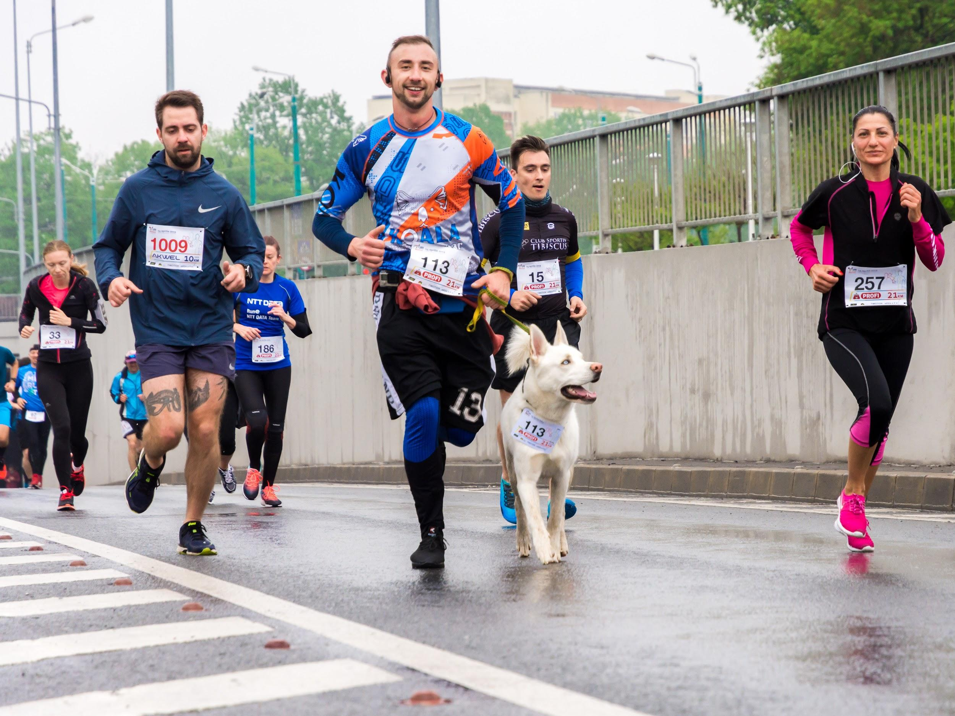
Insight & Need
Community is important….
In starting the journey...
AND continuing it.
Notes:
Community is important in not only lowering the inertia and the daunting-ness of getting started on your wellness journey, it is also important as an accountability tool; as a form of support that encourages you to continue the marathon by following through with your daily habits, to help you build a solid routine such that you can reach your wellness goals.

Slide 23
Insight & Need
Community is important….
In starting the journey...
AND continuing it.
Need: Support channels that offer encouragement, while ensuring accountability.
Notes:
Community is important in not only lowering the inertia and the daunting-ness of getting started on your wellness journey, it is also important as an accountability tool; as a form of support that encourages you to continue the marathon by following through with your daily habits, to help you build a solid routine such that you can reach your wellness goals.

Slide 24
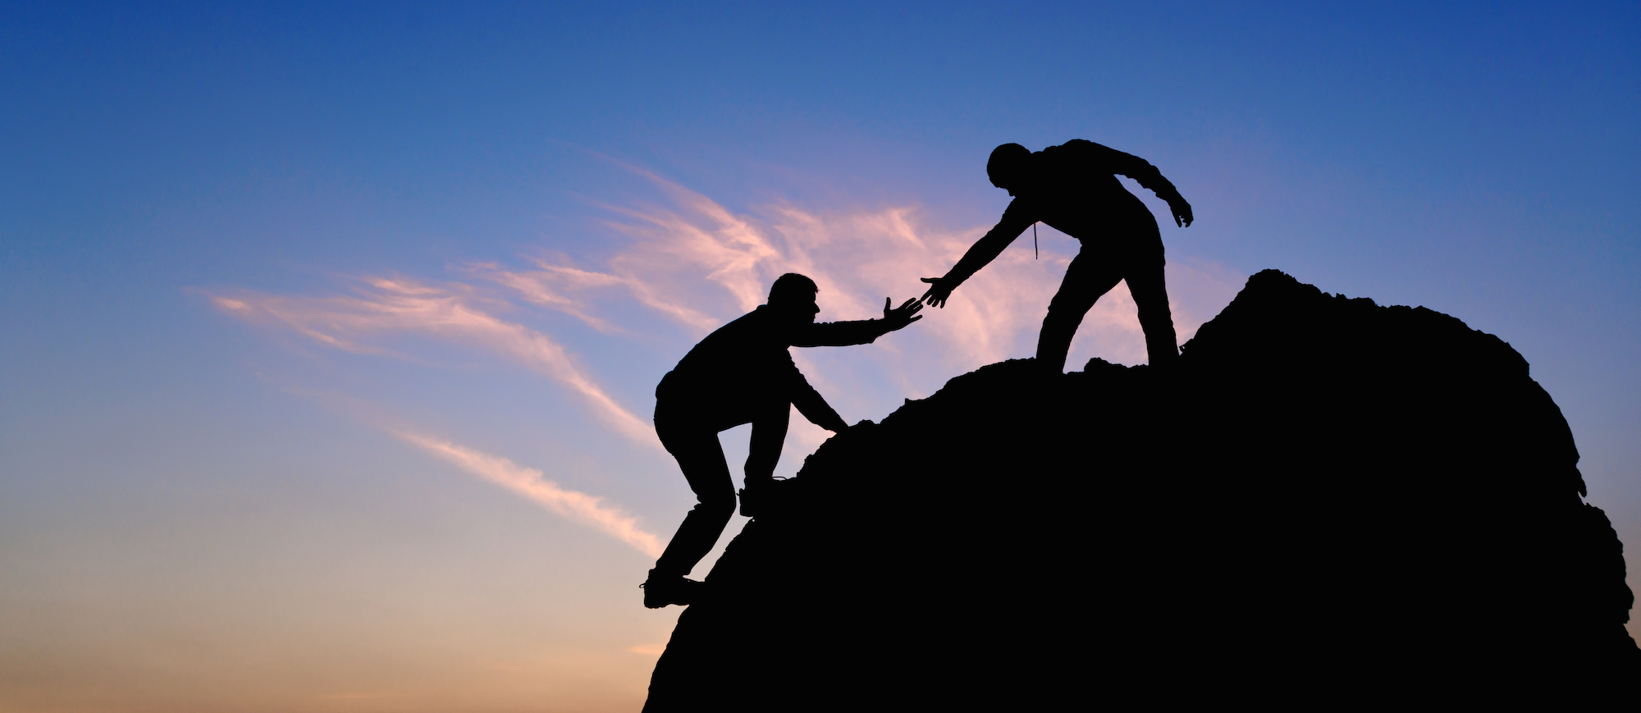
Insight & Need
There are many people who want to start their own fitness journey or have questions towards personal wellness, but feel intimidated when reaching out to others.

Slide 25
Insight & Need
There are many people who want to start their own fitness journey or have questions towards personal wellness, but feel intimidated when reaching out to others.
Need: An easier, less intimidating, way to begin working on personal wellness and outreach for help.

Slide 26
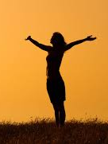
Insight & Need
The fundamental baseline of personal wellness is being able to wake up and have the functional physical/mental strength to do the things they want to do.

Slide 27
Insight & Need
The fundamental baseline of personal wellness is being able to wake up and have the functional physical/mental strength to do the things they want to do.
Need: Ways to protect this functionality and preserve it as they get older.

Slide 28
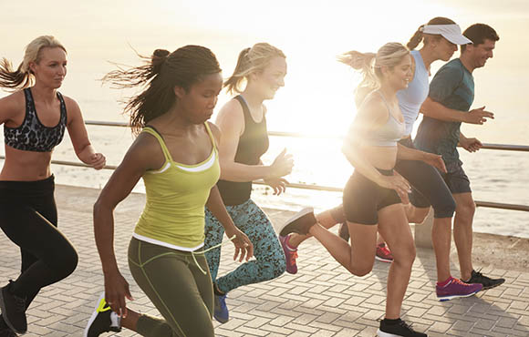
Summary
Wide range of interviewees
Identified common themes among interviewees:
Social Aspect /Community
Routines
Asking for help
Functionality of health
Next steps: more interviews to identify gaps, develop user POVs
Notes:
For this part i think it might be cool to discuss like next steps also.
Like interviewing people in the area of community, routine, asking for help, and functional wellbeing.

Slide 29
Questions?

